Slide 1
Ministry That Fits

Slide 2
What Does A Vibrant Ministry Look Like?

Slide 3
Personal Context
First Baptist Church Of Englewood
Ebenezer AME Church
Community Of Hope AME Church

Slide 4
Fish Sandwich Theology
5 When Jesus looked up and saw a great crowd coming toward him, he said to Philip, “Where shall we buy bread for these people to eat?” 6 He asked this only to test him, for he already had in mind what he was going to do.
7 Philip answered him, “Eight months’ wages would not buy enough bread for each one to have a bite!”
8Another of his disciples, Andrew, Simon Peter’s brother, spoke up, 9 “Here is a boy with five small barley loaves and two small fish, but how far will they go among so many?”

Slide 5
Ask The Right Questions
Who?
What?
When?
Where?
Why?
How?

Slide 6
Who?
Who is Your You
Demographic
Geographic
www.perceptgroup.com
www.thearda.com/congregations.asp
Notes:
Education, Violence & HIV AIDS
Free is a great word
Human resources
Go to the hospital
Bury people well
Vote Woke

Slide 7
What?
Are their needs (perceived and factual)
Do they like (worship style, music, clothes, food, etc.)
Do they dislike
Are the primary ways they receive information
Are your strengths and weaknesses
Are your resources
Notes:
Education, Violence & HIV AIDS
Free is a great word
Human resources
Go to the hospital
Bury people well
Vote Woke

Slide 8
When?
Do they do what they do
Will they be most open
Will they be least open
Can you connect with them
Do you want to start

Slide 9
Where?
Do they work
Do they go for fun and recreation
Do they go when they are bored
Will you connect with them
Do you want them to end up going
Notes:
Started in strip club
Now in shopping mall
Hope Fallfest

Slide 10
Why?
Would they want to get connected
Do you want to get connected (discipleship)
Why would they stay

Slide 11
How?
Do you make it work (Strategic Plan)
How do you keep it working
How do you evaluate how effectively it’s working
How do you fix areas that are not working well

Slide 12

SHEETS

Slide 13
7 P’s Of Relevant Churches
Places
People
Problems
Partners
Policy
Power
Positivity

Slide 14
Places

Slide 15


Slide 16
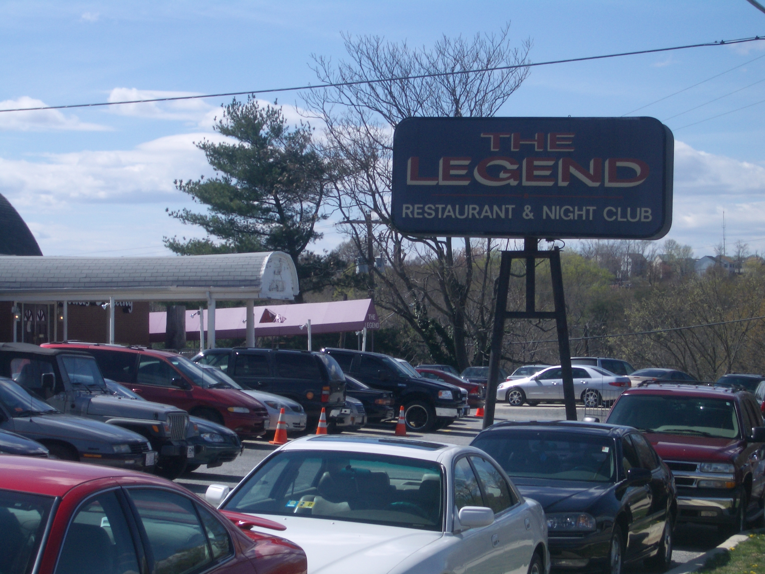

Slide 17
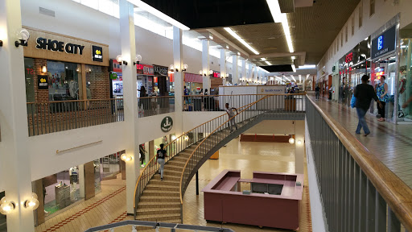

Slide 18
People

Slide 19


Slide 20
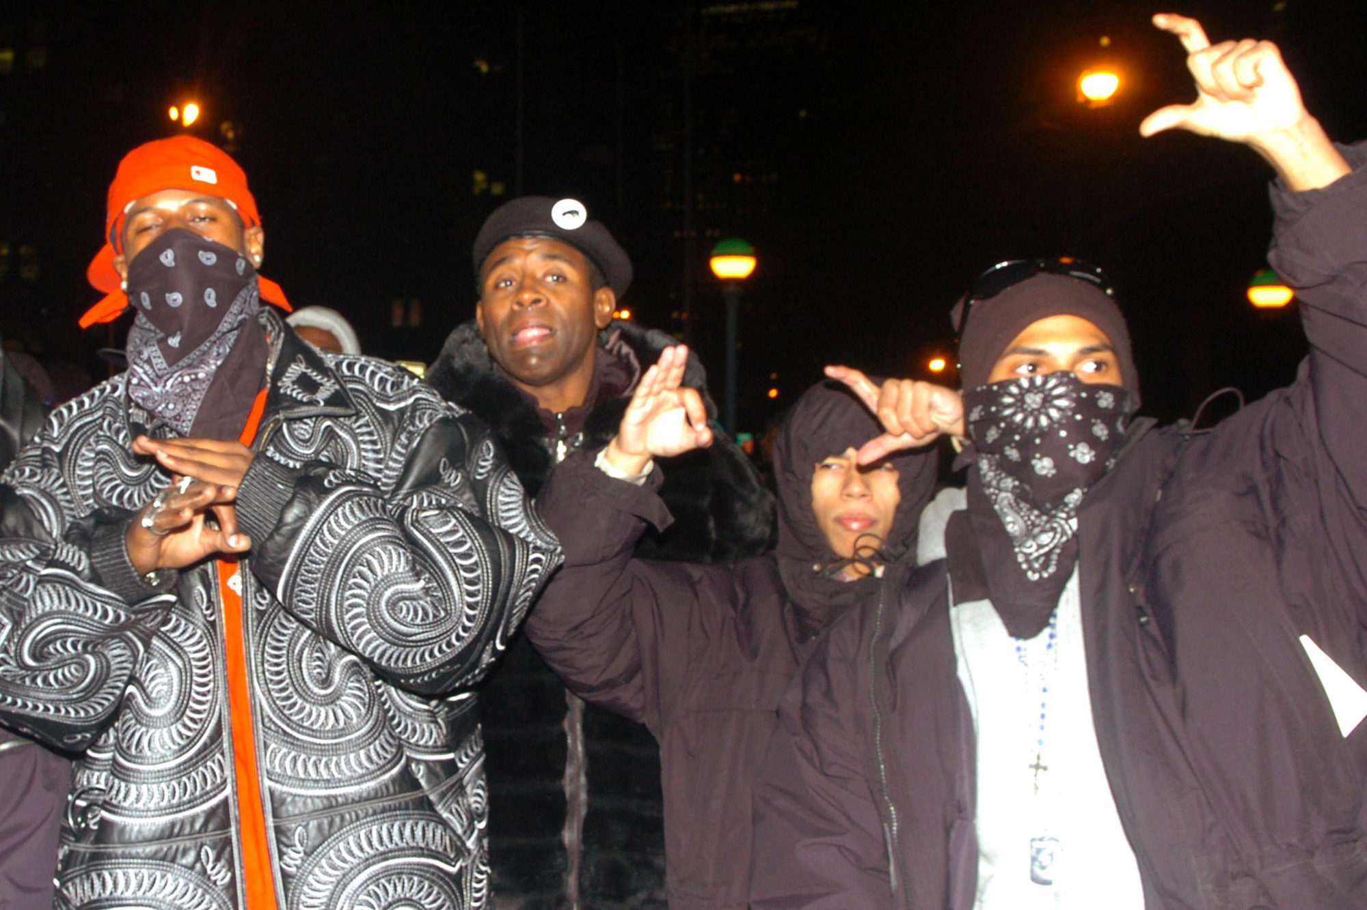

Slide 21


Slide 22


Slide 23
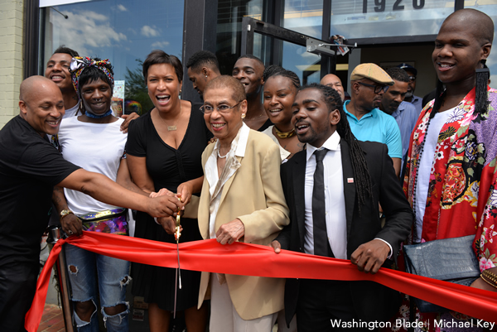

Slide 24
Problems

Slide 25

Suburbanization Of Poverty

Slide 26
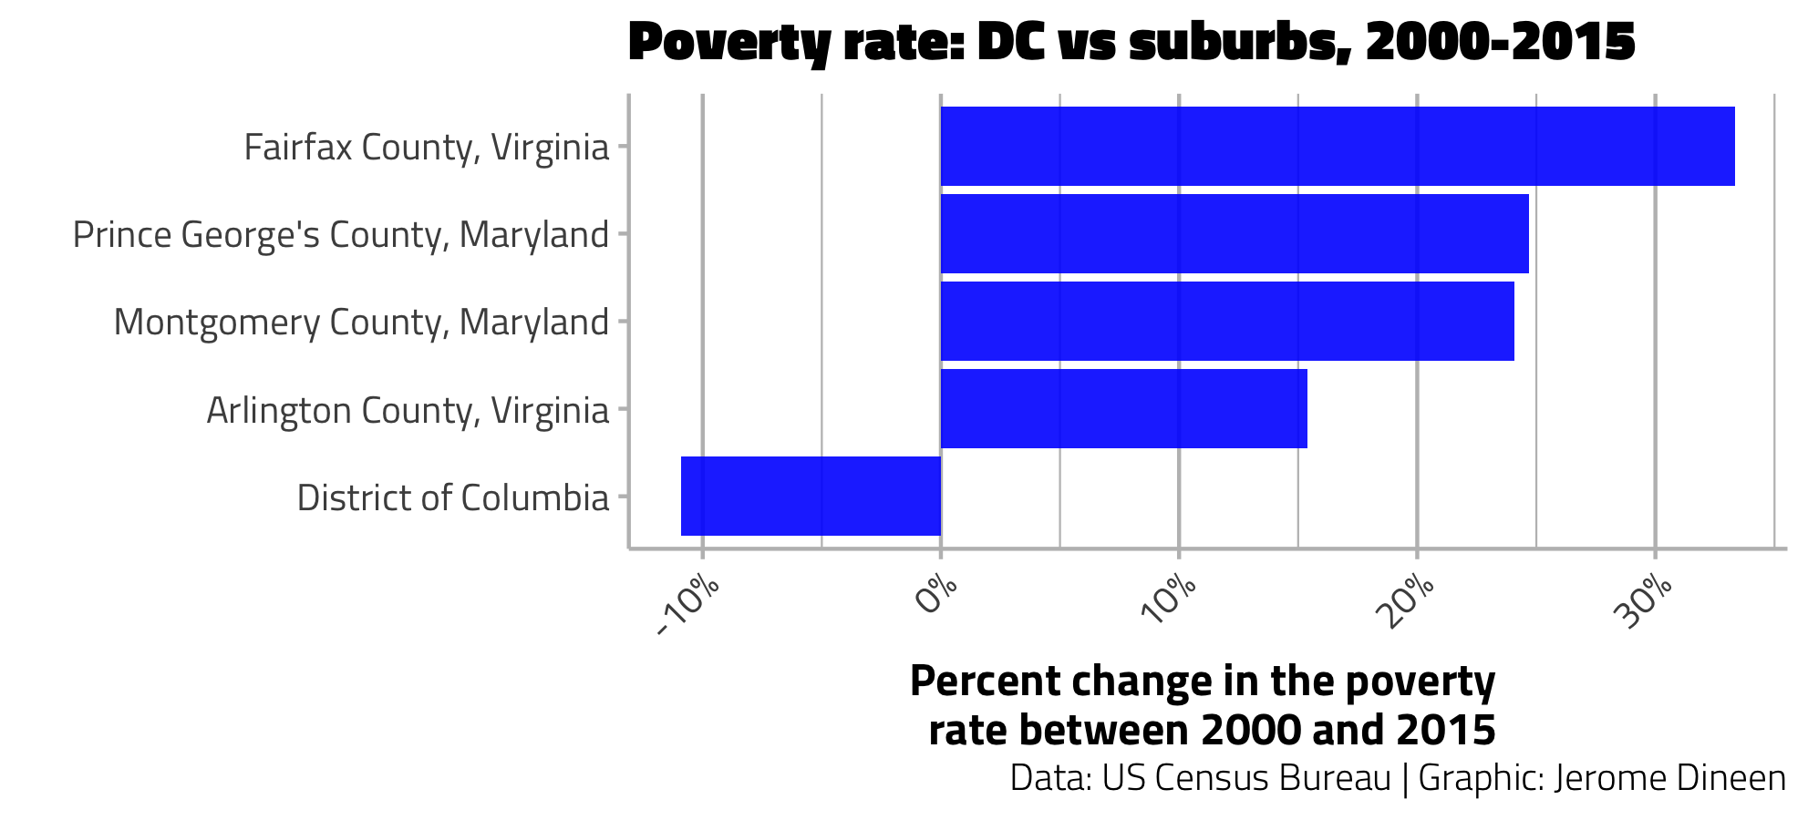

Slide 27
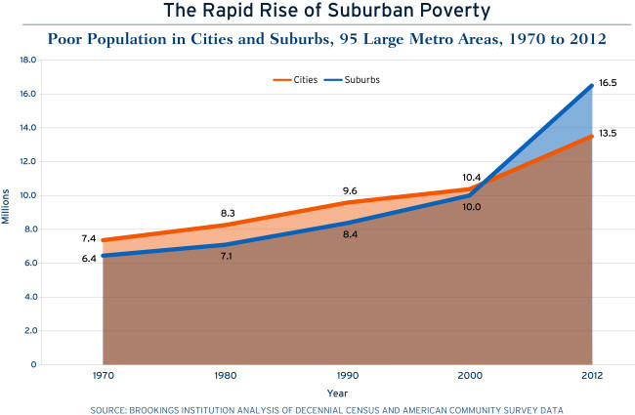
Notes:
Drivers: continued suburbanization of jobs
Downturns in the economy
Prevalence of low wage jobs

Slide 28
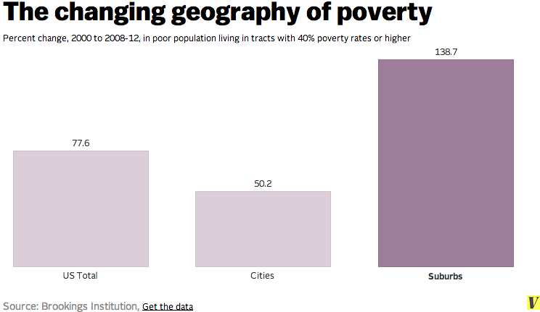

Slide 29
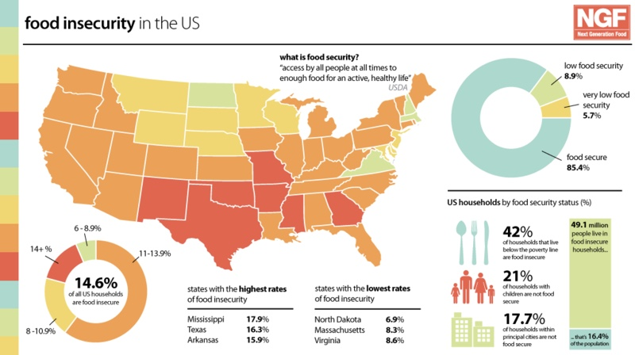

Slide 30


Slide 31
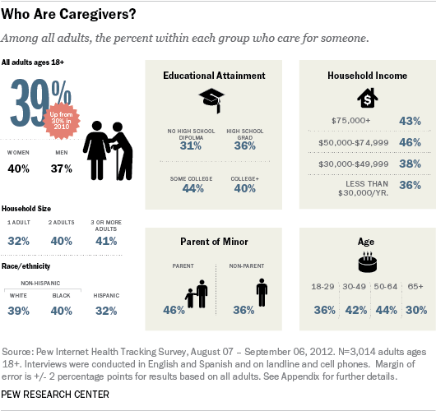

Slide 32
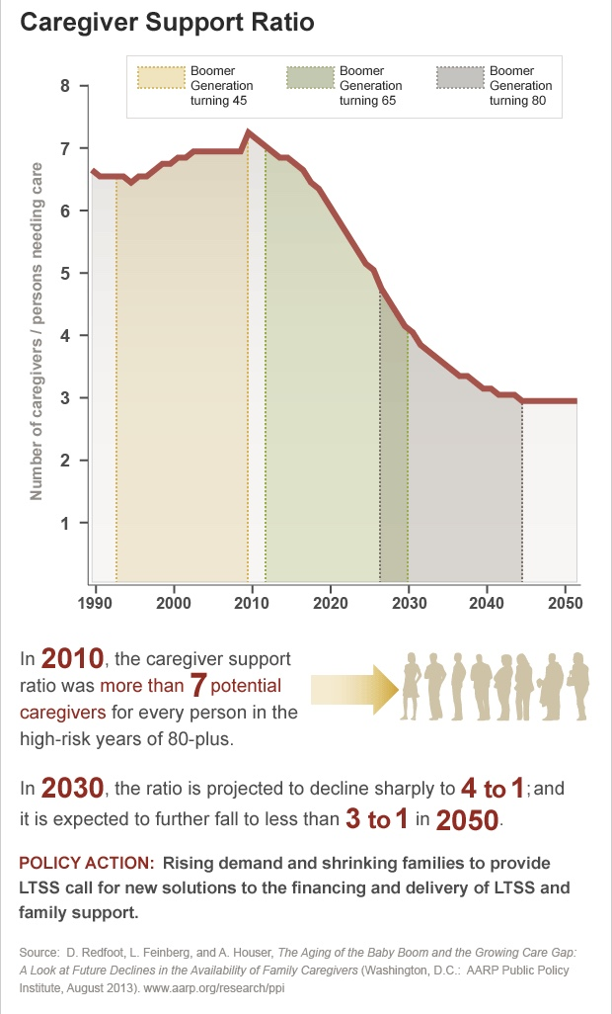
Notes:
Caregiver Gap
The majority of long-term services and supports are provided by family members. But the supply of family caregivers is unlikely to keep pace with future demand. The following report defines a “caregiver support ratio” as the number of potential caregivers aged 45–64 for each person aged 80 and older. The report uses this support ratio to estimate the availability of family caregivers during the next few decades. In 2010, the caregiver support ratio was more than 7 potential caregivers for every person in the high-risk years of 80-plus. By 2030, the ratio is projected to decline sharply to 4 to 1; and it is expected to further fall to less than 3 to 1 in 2050, when all boomers will be in the high-risk years of late life.

Slide 33
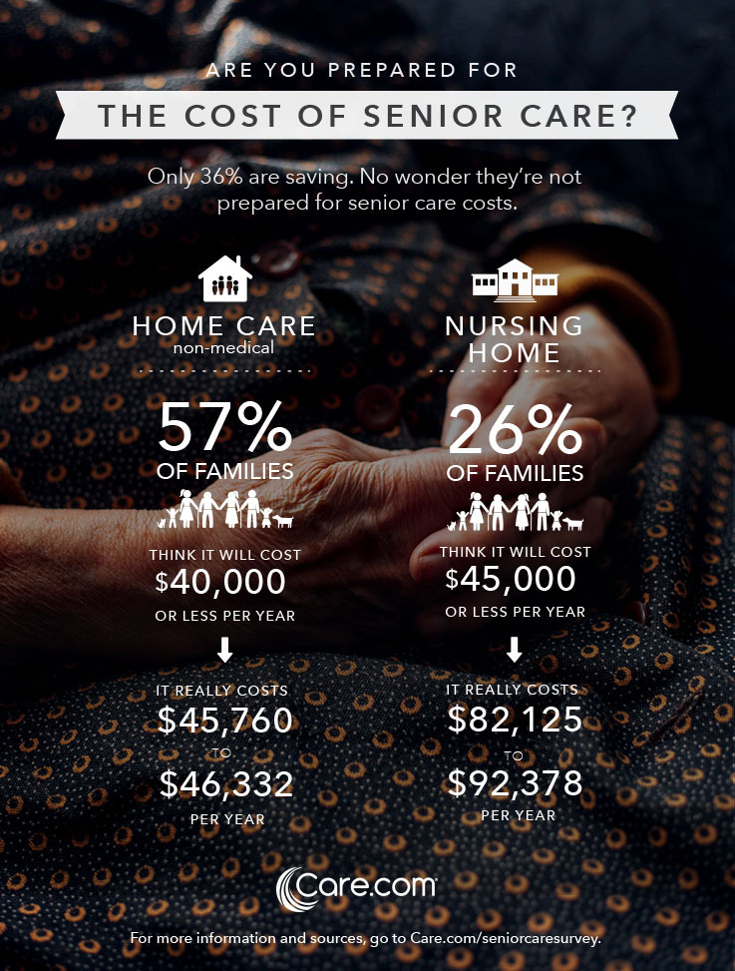

Slide 34


Slide 35
Partners

Slide 37
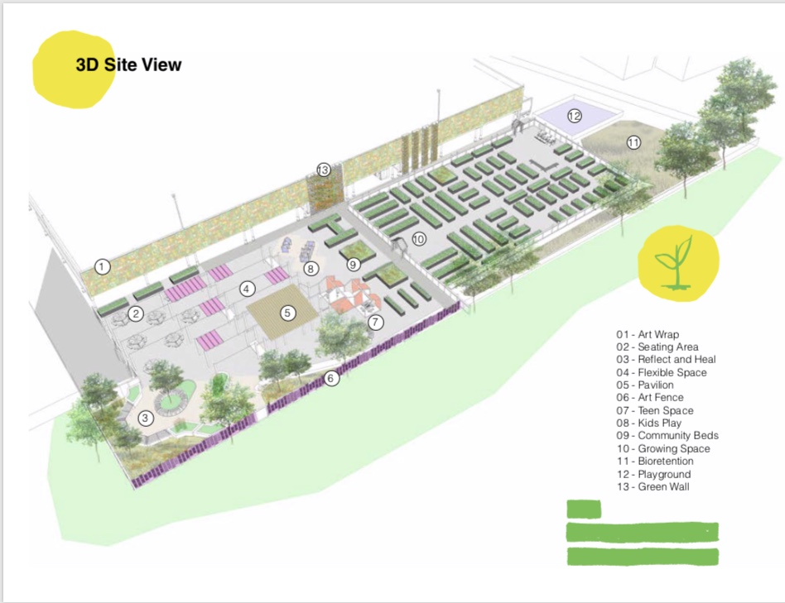

Slide 38
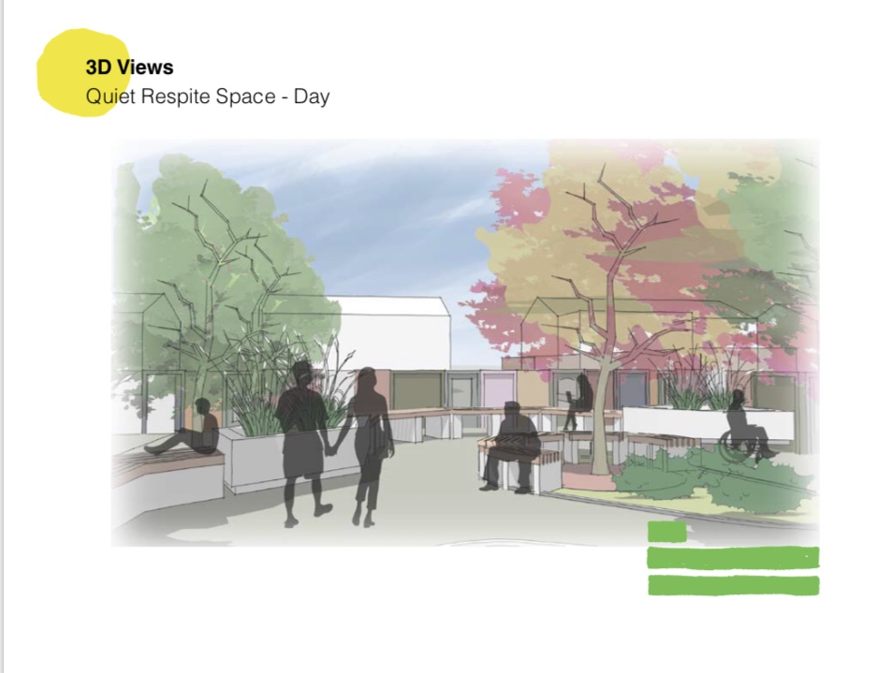

Slide 39
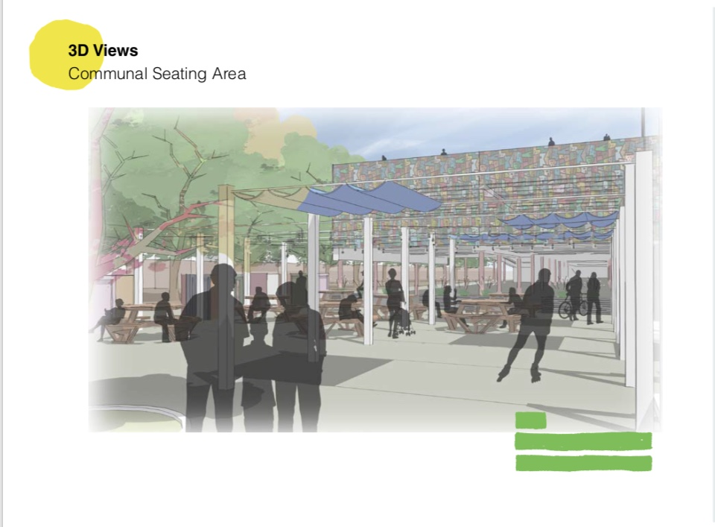

Slide 40
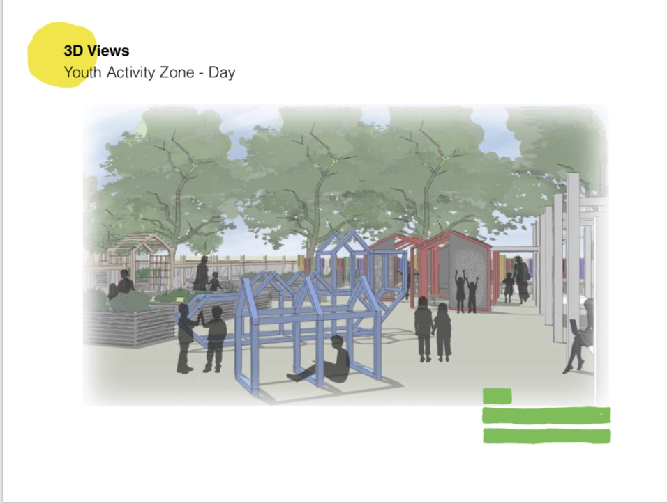

Slide 41
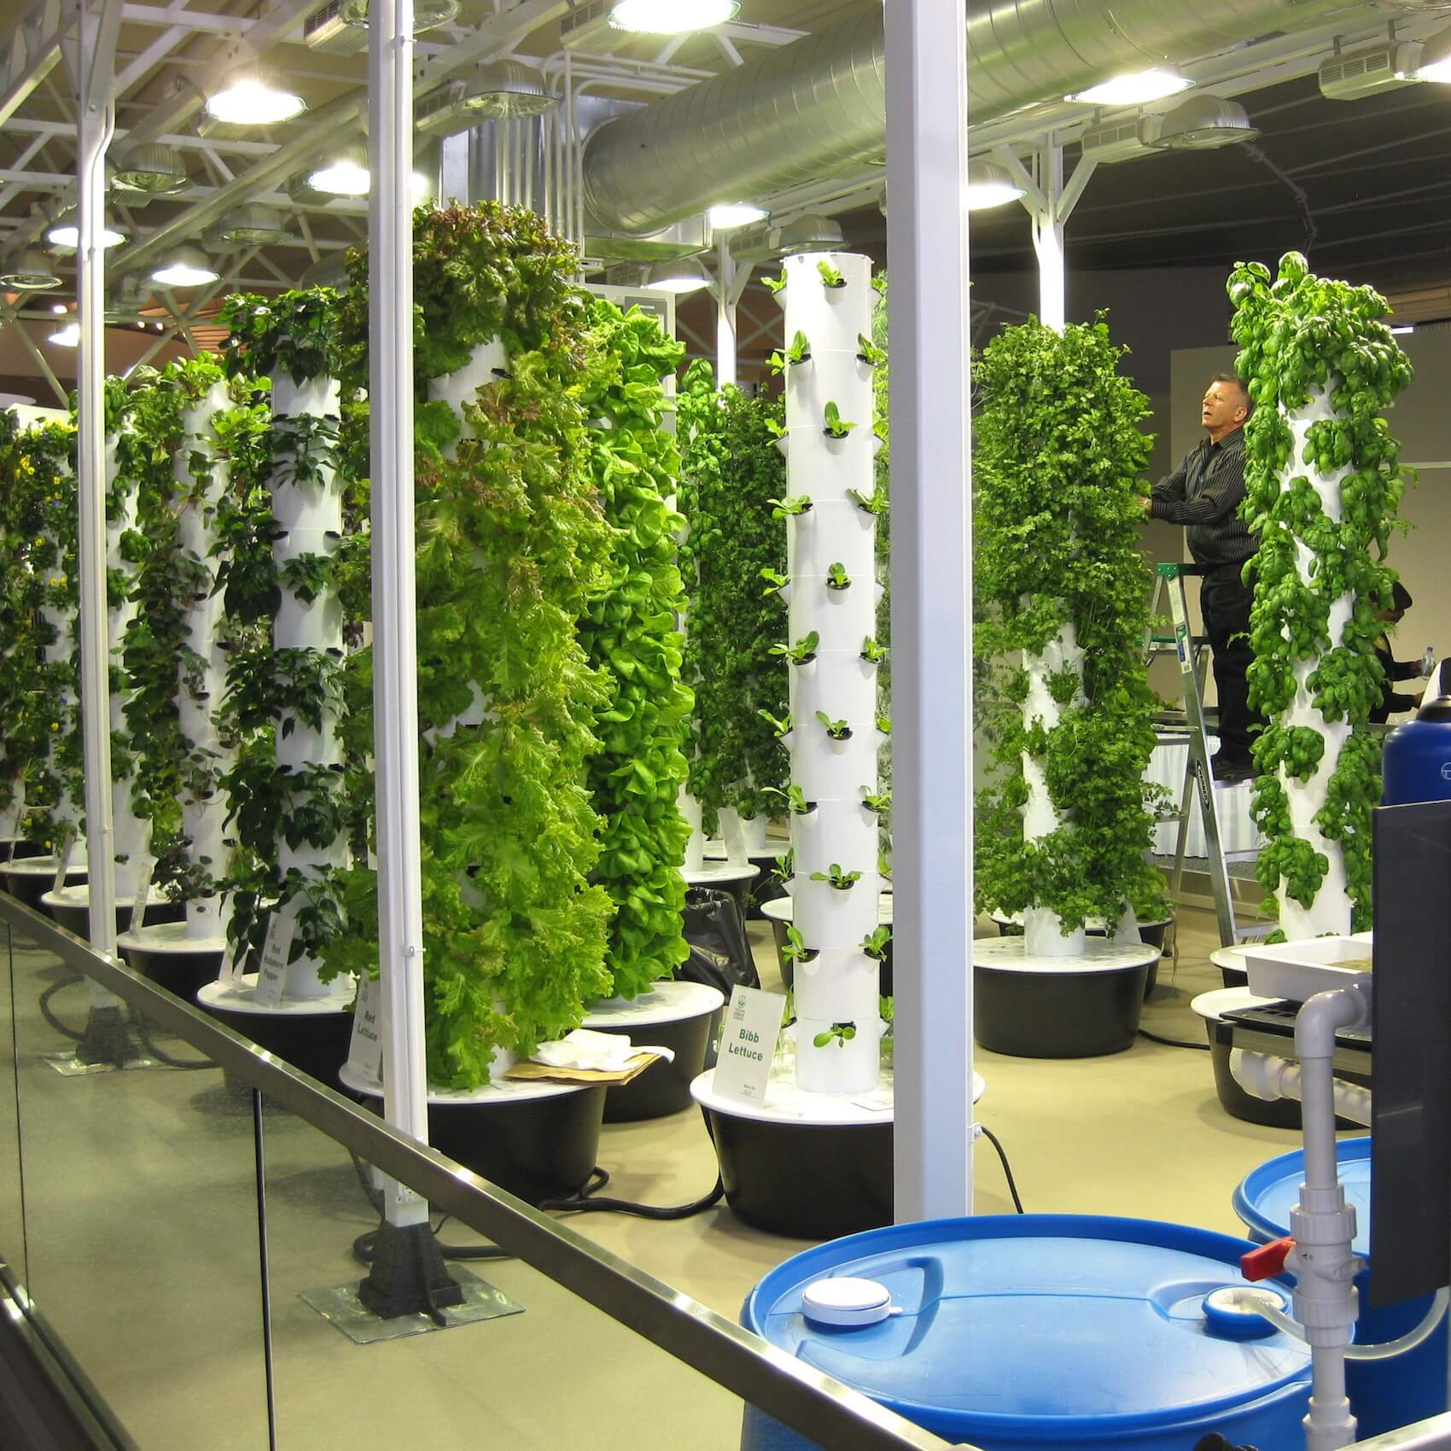

Slide 42
Policy

Slide 43


Slide 44
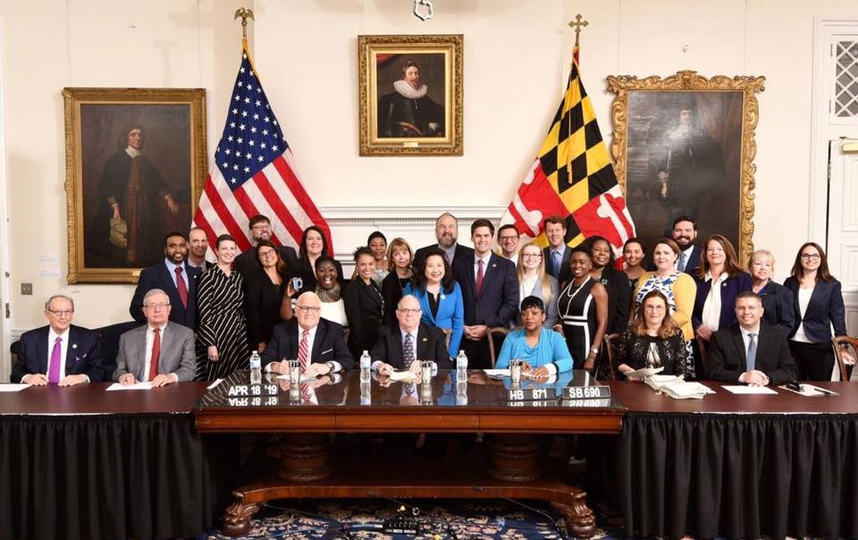

Slide 45


Slide 46
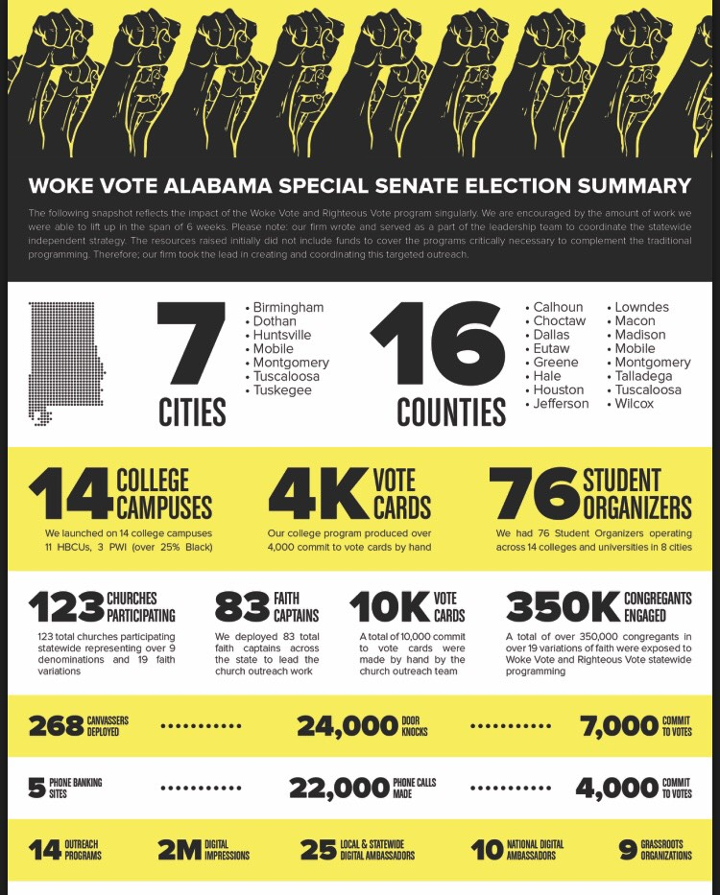
www.blackchurchpac.com www.wokevote.us

Slide 47
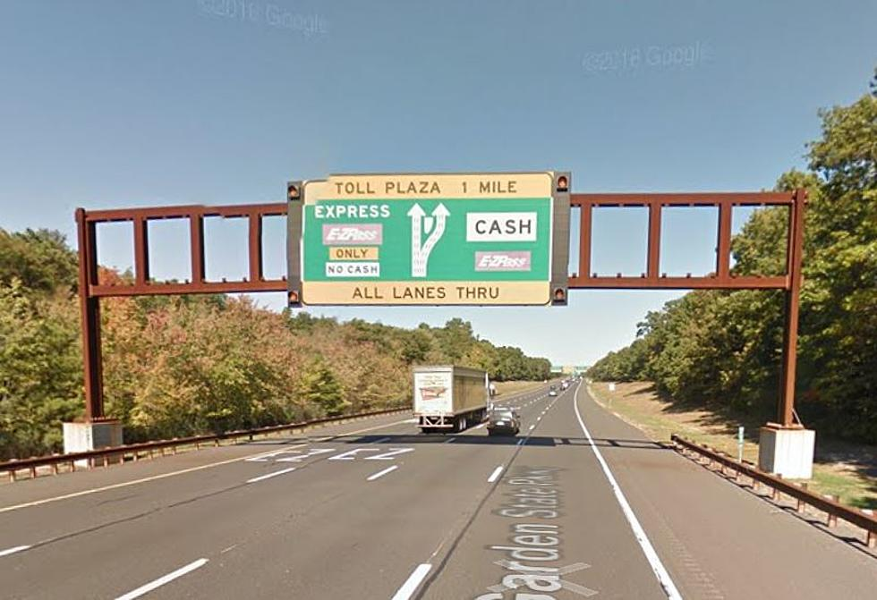
What’s Your Lane
Notes:
HIV/AIDS
Violence
Education

Slide 48
Power

Slide 49
Acts 2:42-47

Slide 50
Acts 2:42-47
42 They devoted themselves to the apostles’ teaching and to fellowship, to the breaking of bread and to prayer. 43 Everyone was filled with awe at the many wonders and signs performed by the apostles. 44 All the believers were together and had everything in common. 45 They sold property and possessions to give to anyone who had need. 46 Every day they continued to meet together in the temple courts. They broke bread in their homes and ate together with glad and sincere hearts, 47 praising God and enjoying the favor of all the people. And the Lord added to their number daily those who were being saved.

Slide 51
Positivity

Slide 52
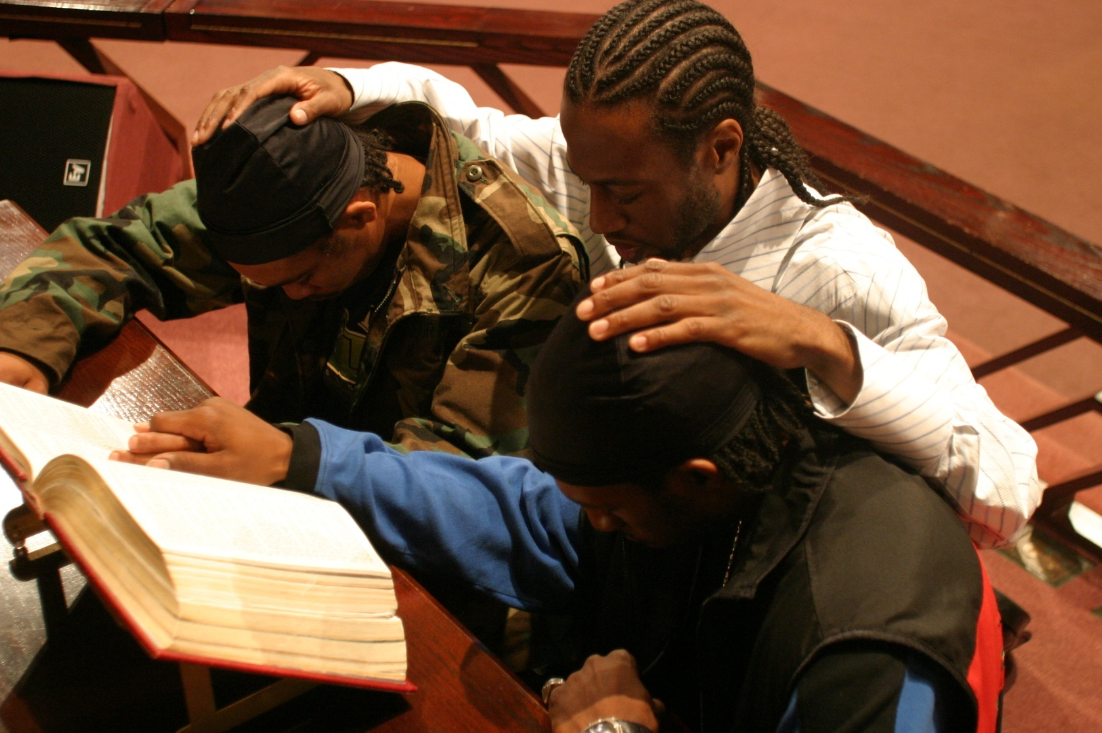
Prayer Changes Things

Slide 53
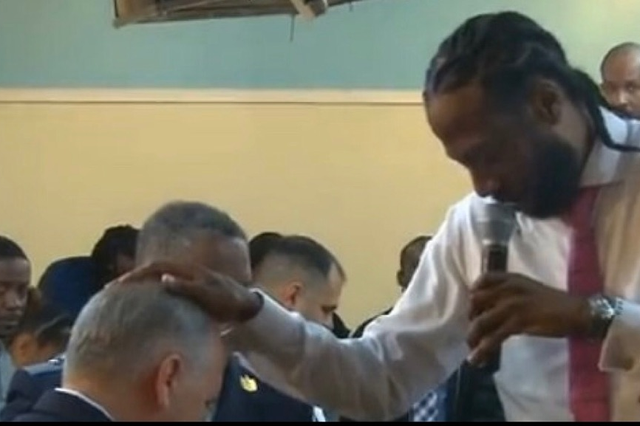
Prayer Changes Things

